Slide 1

Thoughtdata: Opentelemetry Observability Dashboard
IT 4983 W01/W02​​
Privitera
Milestone #3 Report
November 23, 2025
Jaytin Bolling, Daniel Ekema, Da'kobie Garcia, Kian Rezaeinejad ​

Slide 2
Agenda
Progress Summary
Milestone Assessment
Tracking and Performance Assessment
Experiences/Challenges

Slide 3
Progress Summary
The Team has….
Created a working Dashboard that houses Metrics, Traces, Logs
Created Panels that displays such metrics and displays Open-telemetry from the frontend application.

Slide 4
Milestone Assessment/ Summary
Milestone | Date | Status | Summary
Project Plan/Team Discussion | 9/7/2025 | Completed | Project Plan was revised twice and further assessed to meet deliverables.
Framework and Architecture design | 11/9/2025 | Completed | Figma design was a rough draft and design has further developed
Working Prototype with simulated telemetry + frontend demo | 11/14/2025 | Completed | Prototype was successful, stakeholder feedback has been assessed.
Final systems with live endpoints, testing, documentation | 12/3/2025 | Completed | Grafana Dashboard has been made.

Slide 5
Milestone Assessment [Project Plan a. ]
The Project Plan has been completed and updated.
Roles were established and changes that were made to deliverable times has been further assessed and updated since previous Milestone.
The MS Project has been updated to show completion of the tasks.

Slide 6
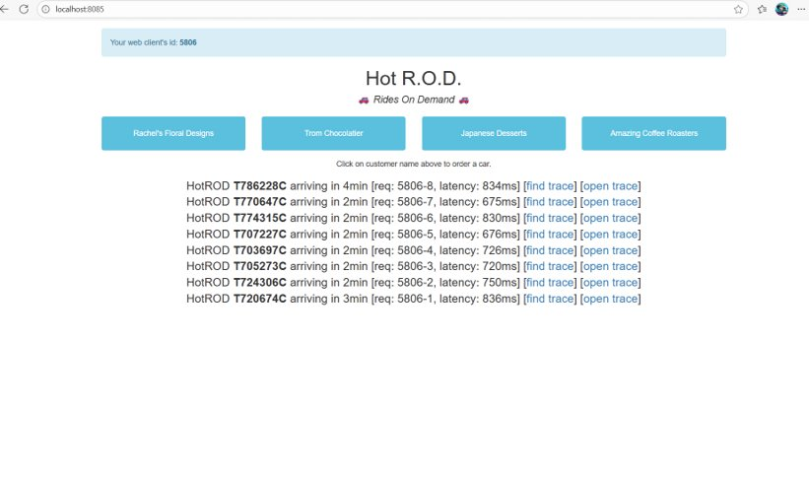
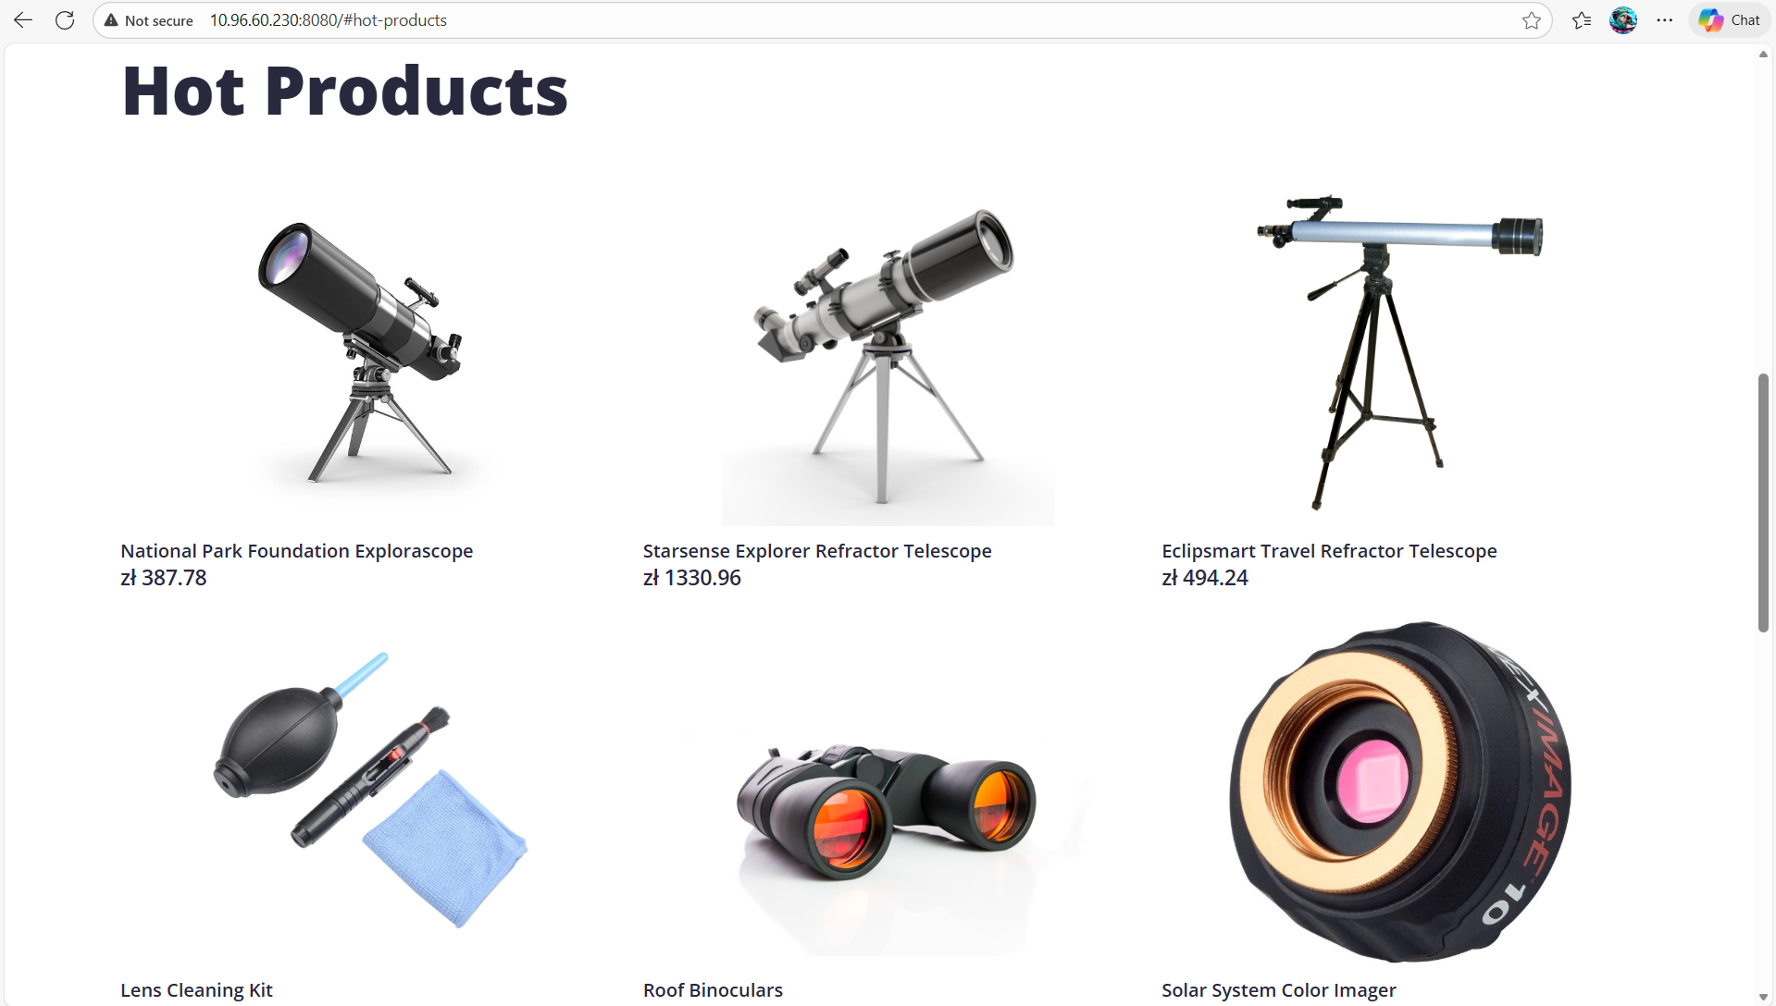
Milestone Assessment [Project Plan b. ]
One of the slightest changes we administered was the changing of the frontend. The display went from the HOTROD application to a better more suitable UI called OTEL demo.

Slide 7
Milestone Assessment [Framework a.]
The Framework and Design was originally designed through figma. The design was to the teams best understanding of how the dashboard should work but later was shifted to the display of Grafana
Now the Framework follows the Grafana Dashboard’s standards to display OTEL Dashboard panels.
The design displays Errors and activity, which gives useful information about the status of the whole conjunction.
Elastisearch and Prometheus
Grafana
Dashboard
OTEL Demo
Docker Desktop

Slide 8
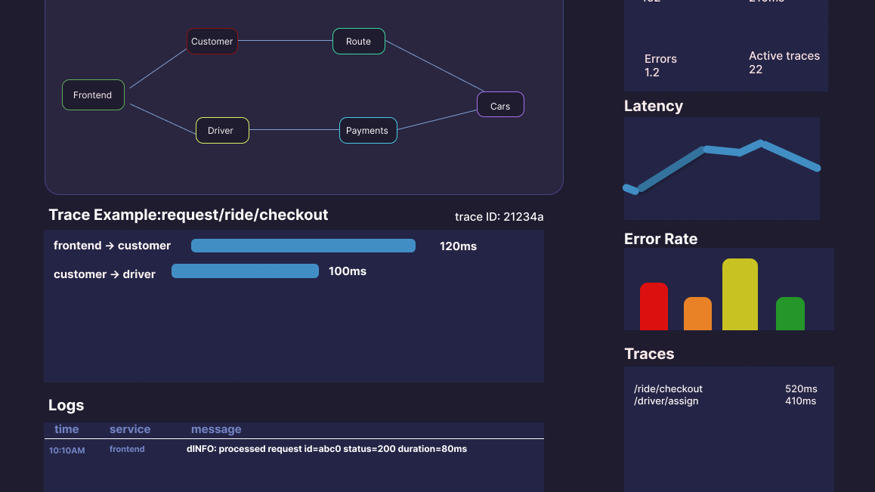
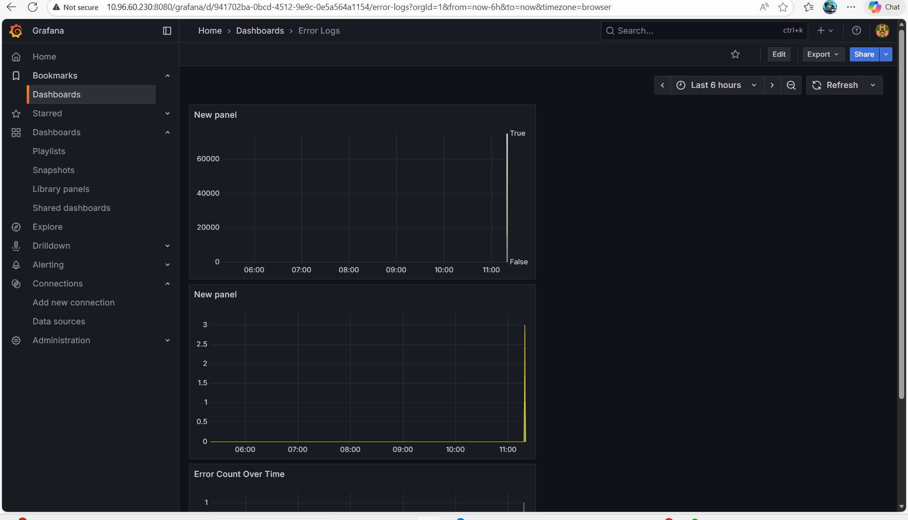
Milestone Assessment [Framework b.]
The original architecture was a prenotion design before further evaluating how Grafana works.
The bottom is the correct and what to expect from the Grafana Dashboard.

Slide 9
Milestone Assessment [Prototype]
The prototype showed how Grafana was running with the frontend and hosted to the server.
This was an opportunity to get feedback on what could be better and what should be the next steps which the biggest callout was the use of open search instead of Elasticsearch, which we finished connecting!
Reminder:
Prototype benefits | Prototype Components | Features
Faster issue detection Unified Observability Scalability for cloud analytics | Grafana for visualization of metrics, logs and traces OTEL collector for data export | Real time dashboard Alert integration for latency and error spikes

Slide 10
Milestone Assessment [Final System]
The Final system runs simultaneously with the frontend shopping site and also displays real-time run errors if one was to occur.
The system is designed to show log errors from Elastisearch and give useful metrics!
Displays Time Logs, Error Rate over time, Active HTTP Requests, Error and Warning Logs, Logs.

Slide 11
Team Member Contributions
Team Member | Contributions
Kian Rezaeinejad (Team Lead) | Helped in creating the Project’s Plan and defining the requirements, helped in weekly log contributions, created research papers for the milestone. Helped organize meetings and set up a communication pipeline amongst the team. Helped with testing the prototype and test the compiling of the program local. Helped with creating panels for the final dashboard.
Jaytin Bolling | Helped in creating the project’s plan and defining the requirements, aided in weekly log contributions, helped with the research papers and getting them to the library for review, and aided in creation of Milestone PowerPoints, helped with creating panels in the final dashboard.
Daniel Ekema | Helped define the Project, Updated projects requirements to further stay within project scope, aided in weekly logs, designed the Figma design and helped in fitting the design to the prototype, helped start the backend and frontend connections through docker and further expanded from local hosting to the server. Discovered both frontend UI. Started the Grafana Dashboard and started the Dashboard and created panels for the final dashboard. Created multiple connections for personal connections for each team member to connect to Grafana through their user on the server.
Dakobie Garcia | Helped expand the projects plan, Updated the plans to better fit within the project scopes, aided in weekly logs, helped arranged meetings, reiterated the MS project to better fulfill the correct deliverables, helped initialize docker locally and researched about Grafana JSON files, Helped in connecting Grafana to the OTEL collector, helped in testing the connection to the server and links to each frontend, created some panels to the final dashboard.

Slide 12
Experiences/Challenges
Challenges:
understanding how to host Grafana to the server.
understanding how JSON files worked and how we would be utilizing them.
Creating panels for the dashboard that satisfied the projects scope.
Experiences:
With the project in general, sticking to the project’s timeline and more relying on being told next directives instead of expanding on ideas with each other and failing to communicating these ideas early.
Vulnerabilities to being ignorant to something new, rather than asking critical questions to further understanding the project.

Slide 13
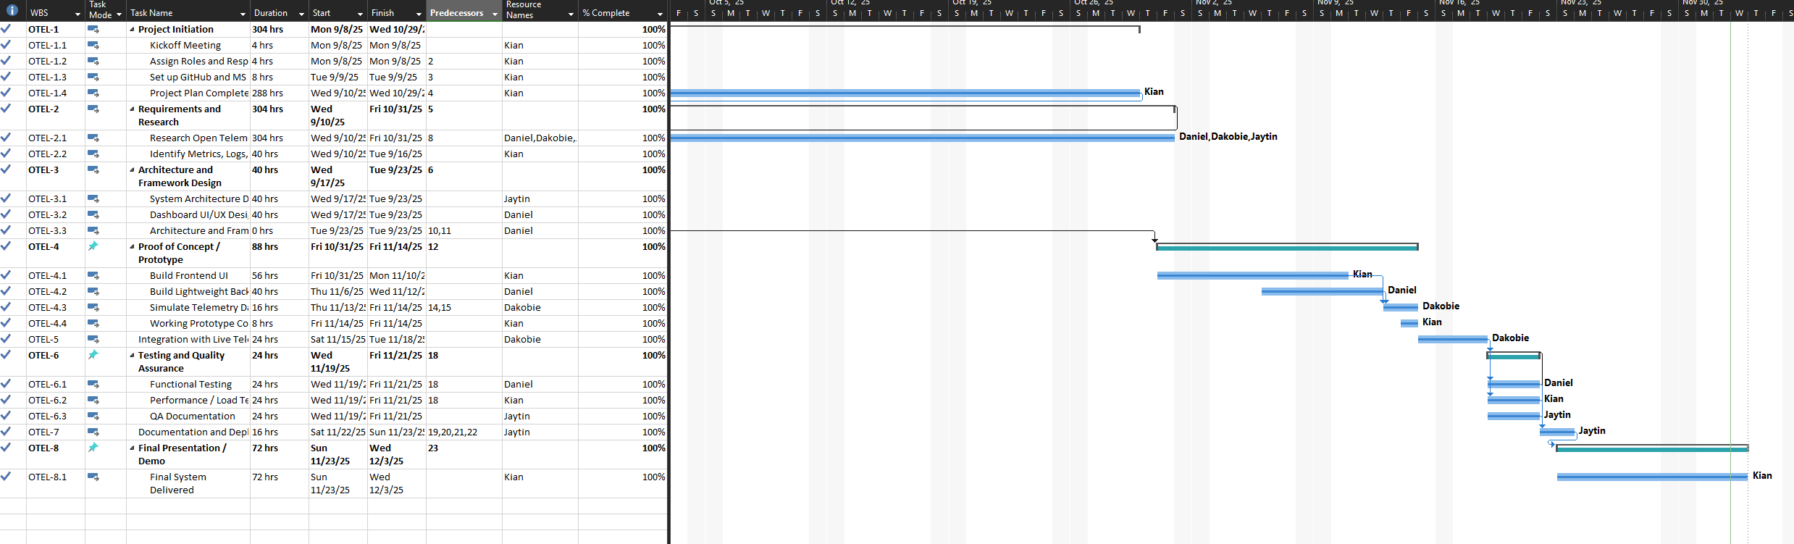
Gannt Chart

Slide 14
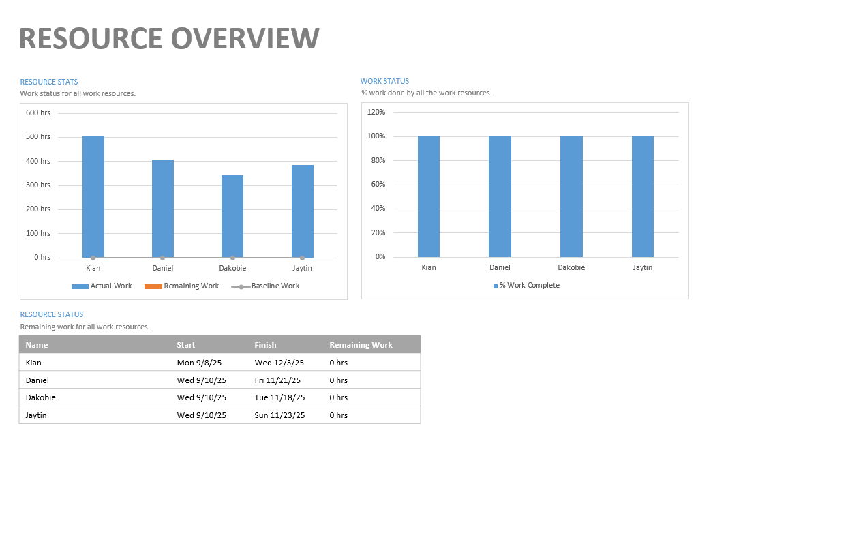
Resource Overview

Slide 15
Questions/ Concerns/ Feedback?
Thankyou for tuning in to the Milestone

